Slide 1

AWS Key Management Service (KMS)
Efficiently manage encryption keys in the cloud

Slide 2
Introduction
AWS Key Management Service (KMS) is a fully managed service that simplifies the creation and control of encryption keys. It enables users to easily encrypt data across AWS services and applications while managing access to keys securely. KMS integrates seamlessly with other AWS services, providing a robust framework for cryptographic operations and enhancing overall data security.

Slide 3
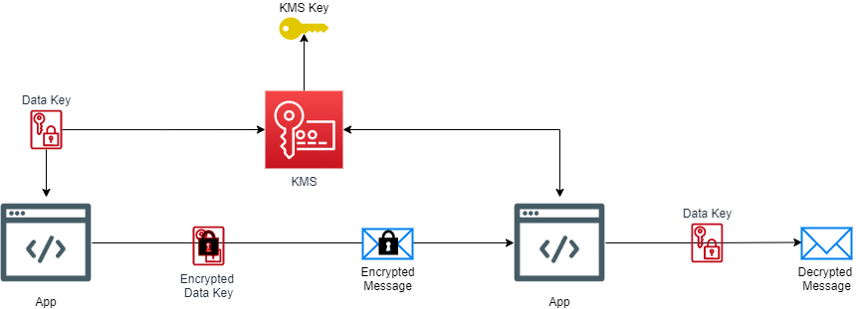
What is AWS KMS?
AWS KMS is a cloud service that enables users to create, manage, and control encryption keys for their data. It is designed to make it easy to encrypt data across a variety of AWS services, providing a centralized platform for key management. It supports key rotation, access control policies, and integrates with various AWS services for streamlined operations.

Slide 4

Key Features of AWS KMS
AWS KMS offers several features that enhance data security, including centralized key management, automatic key rotation, and detailed access control policies. It supports encryption using both symmetric and asymmetric keys, allows for audit logging of key usage, and complies with various industry standards to ensure data protection across AWS architectures. These features make KMS a vital tool for secure cloud operations.

Slide 5
Benefits of Using AWS KMS
AWS Key Management Service (KMS) provides significant benefits for organizations seeking secure data management. It offers centralized key management, simplifying the process of creating and controlling encryption keys across multiple services. KMS enhances compliance with regulatory standards and provides audit capabilities, ensuring security practices are documented. Additionally, automatic key rotation enhances security while reducing administrative overhead, allowing organizations to maintain robust data protection effortlessly.

Slide 6

02
Practical Examples of AWS KMS

Slide 7
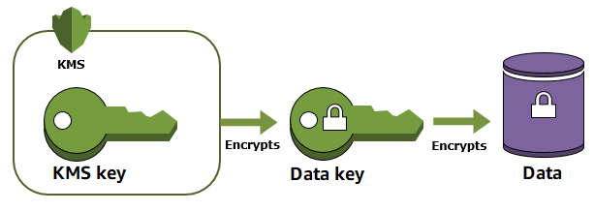
Use Case: Data Encryption
AWS KMS is commonly used to encrypt sensitive data, ensuring that only authorized users can access it. By integrating with services like Amazon S3, users can automatically encrypt objects stored in buckets. This integration not only safeguards data at rest but also during transfer. KMS allows organizations to manage keys securely and easily, providing a scalable solution for data encryption across various applications.

Slide 8
Use Case: Integrating with Other AWS Services
AWS KMS integrates seamlessly with other AWS services, such as Amazon RDS and AWS Lambda, providing strong security measures for various workloads. For instance, database encryption can be managed directly through RDS with keys stored and controlled via KMS. This integration simplifies security management and allows developers to focus on building applications while ensuring sensitive data is protected throughout its lifecycle.

Slide 9

Use Case: Managing Encryption Keys
Managing encryption keys is crucial for any organization that handles sensitive information. AWS KMS simplifies this process by providing detailed control over key access and usage. Users can define policies that dictate how and when keys can be utilized by different applications or services, ensuring that only authorized processes have access to sensitive data. This structured approach to key management enhances security and compliance across the organization.

Slide 10

Conclusions
In summary, AWS Key Management Service (KMS) is an essential tool for organizations leveraging cloud services. It simplifies encryption and key management, ensuring that sensitive data is secure while remaining easily accessible to authorized users. Through various use cases, including data encryption, integration with AWS services, and effective key management, KMS delivers robust solutions that meet diverse security needs. Organizations can achieve compliance and enhance their overall data protection strategy by implementing AWS KMS effectively.

